Slide 1
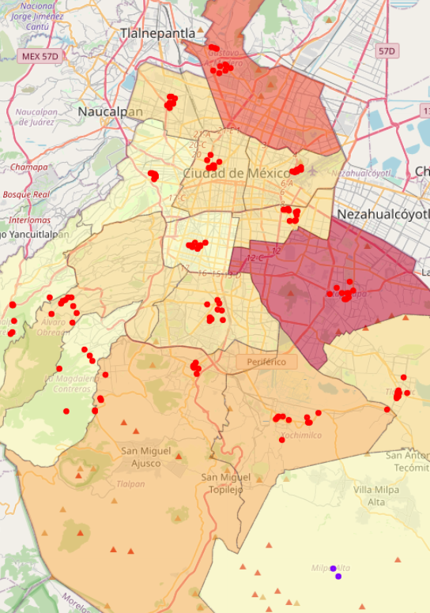

Geographical cluster of the possible COVID-19 infection points in México City.

Slide 2
Backgound
SARS-CoV-2 it’s a virus that has the initial outbreak in Wuhan China in December 2019 and has stopped most of the economic and social activities around the world.
In Mexico City, for example, there are boroughs that are presenting large outbreaks and want to return to economic and social activities.
The problem
Is it possible to classify the busiest places to generate a map of risk of contagion?

Slide 3
Data acquisition and cleaning
The coronavirus data was obtained from the official government website https://datos.cdmx.gob.mx/explore/dataset/casos-asociados-a-covid-19/table/?disjunctive.resultado.
Data containing patient health characteristics were removed
Only the active cases were kept.
Cleaned data contains 2 features

Slide 4
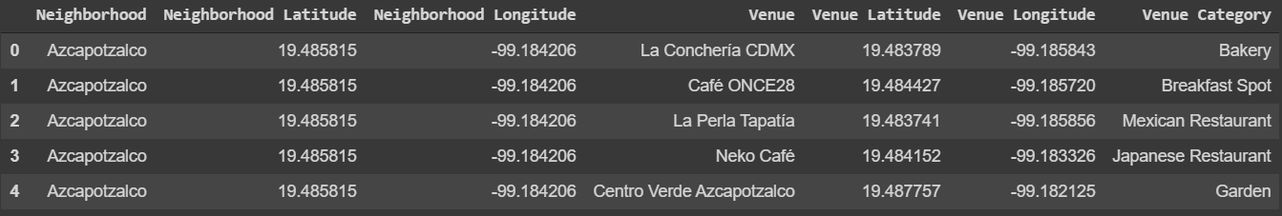
For geographic data, the Foursquare API was used.

Slide 5
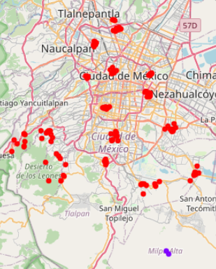
Classification model
The model used is K-means
The model classified the locations into 2 clusters, this may mean that the locations are very similar to each other or that there is a underfitting.

Slide 6
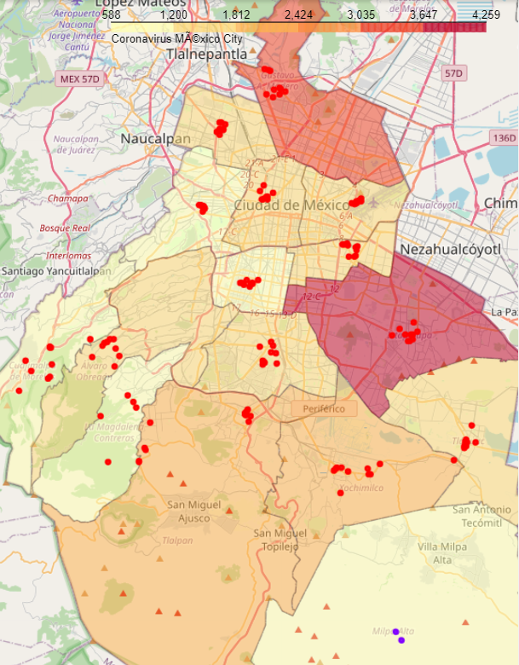
Plot the data into a map
For this step I used a choropleth map and combine whit the coronavirus data to obtain the risk of infection

Slide 7
Conclusion and future directions
Knowing the possible points of risk can help generate better health measures
Accuracy can be improved by sorting places by:
Most visited areas
Places around the infected people

